Slide 1
Faisua Size and Density Correlations with Depth in the National Park of American Samoa
Presentation By: Olyvia Ta’ase
Mentored By: Ian Moffitt
Notes:
Faisua size and denstiy correlations with depth,
In the national park of american samoa

Slide 2
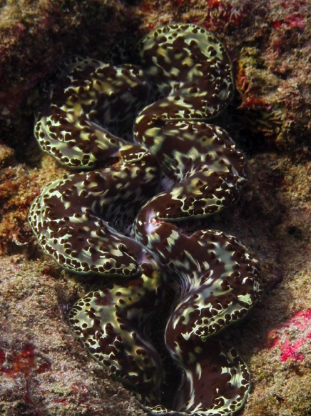
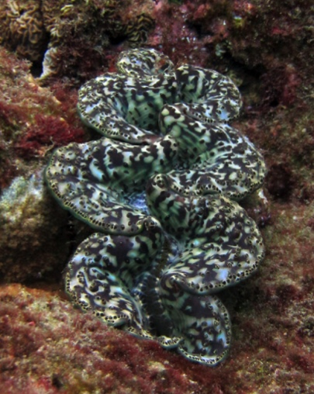
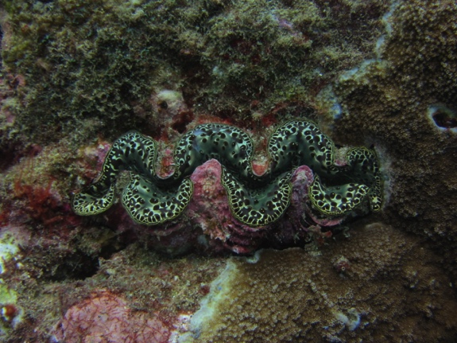
Giant Clams(Faisua)
Giant Clams(Faisua), part of the Tridacnidae family are bivalve mollusks that live among tropical waters in the coral reef ecosystem
Adapt to low nutrient levels in seawater of coral reefs
Notes:
Giant clams locally known as Faisua are large bivalve molluscs of the Tridacnidae Family, that live among tropical waters and adapt to low nutrient levels in the coral reef ecosystem

Slide 3
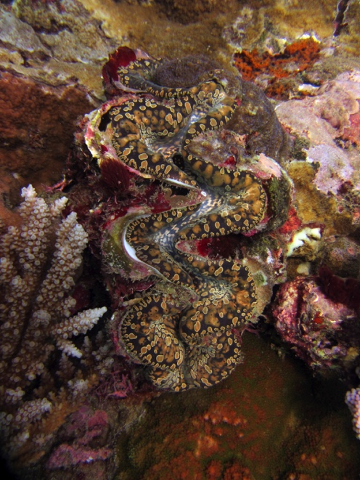
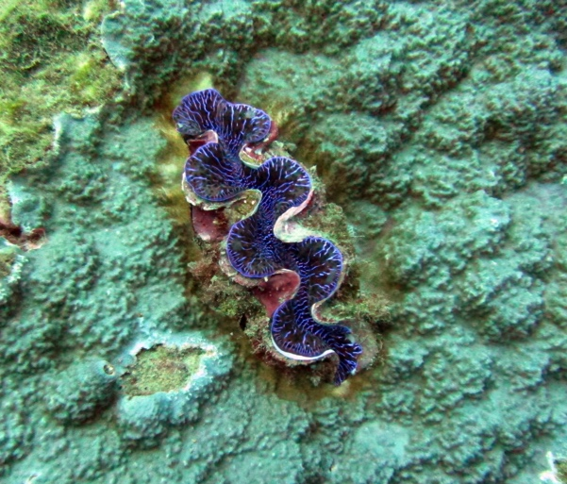
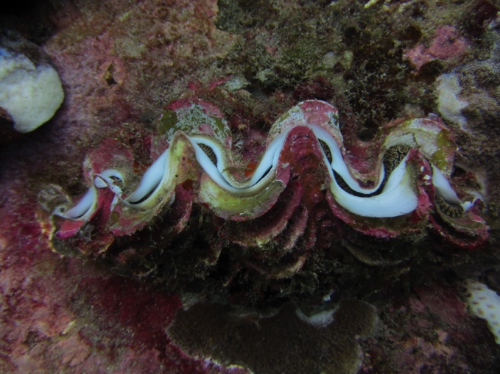
Giant Clams(Faisua)
Typically found in shallow waters
As a source of energy, Faisua harbor photosynthetic zooxanthellae, much like coral.
Notes:
Native to shallow coral reefs
As a source of energy, Mantle tissue – lobe of the act as a sort of habitat for the symbiotic algae for the faisua to get their nutrition

Slide 4
PROBLEM (Threats to Faisua population)
Throughout the years, Tutuila has been experiencing a decline of Faisua population within its Bays
The diminishing population is mainly caused by overfishing (Lucas, 1994) (Green & Craig, 1999).
Notes:
Throughout the years
There has been a decline of faisua population in the bays of tutuila
& according to reasearchers, its decrease may have link with overfishing

Slide 5
PURPOSE
This project focuses on how seawater depth (1m – 30m), drives Faisua size and density distributions. This data can then be used to guide management practices to help bring up population levels.
Notes:
The purpose of this project focuses on HOW different seawater depths of 1-30m
Drives the size and density of faisua DIS TREH BYU SHEN

Slide 6
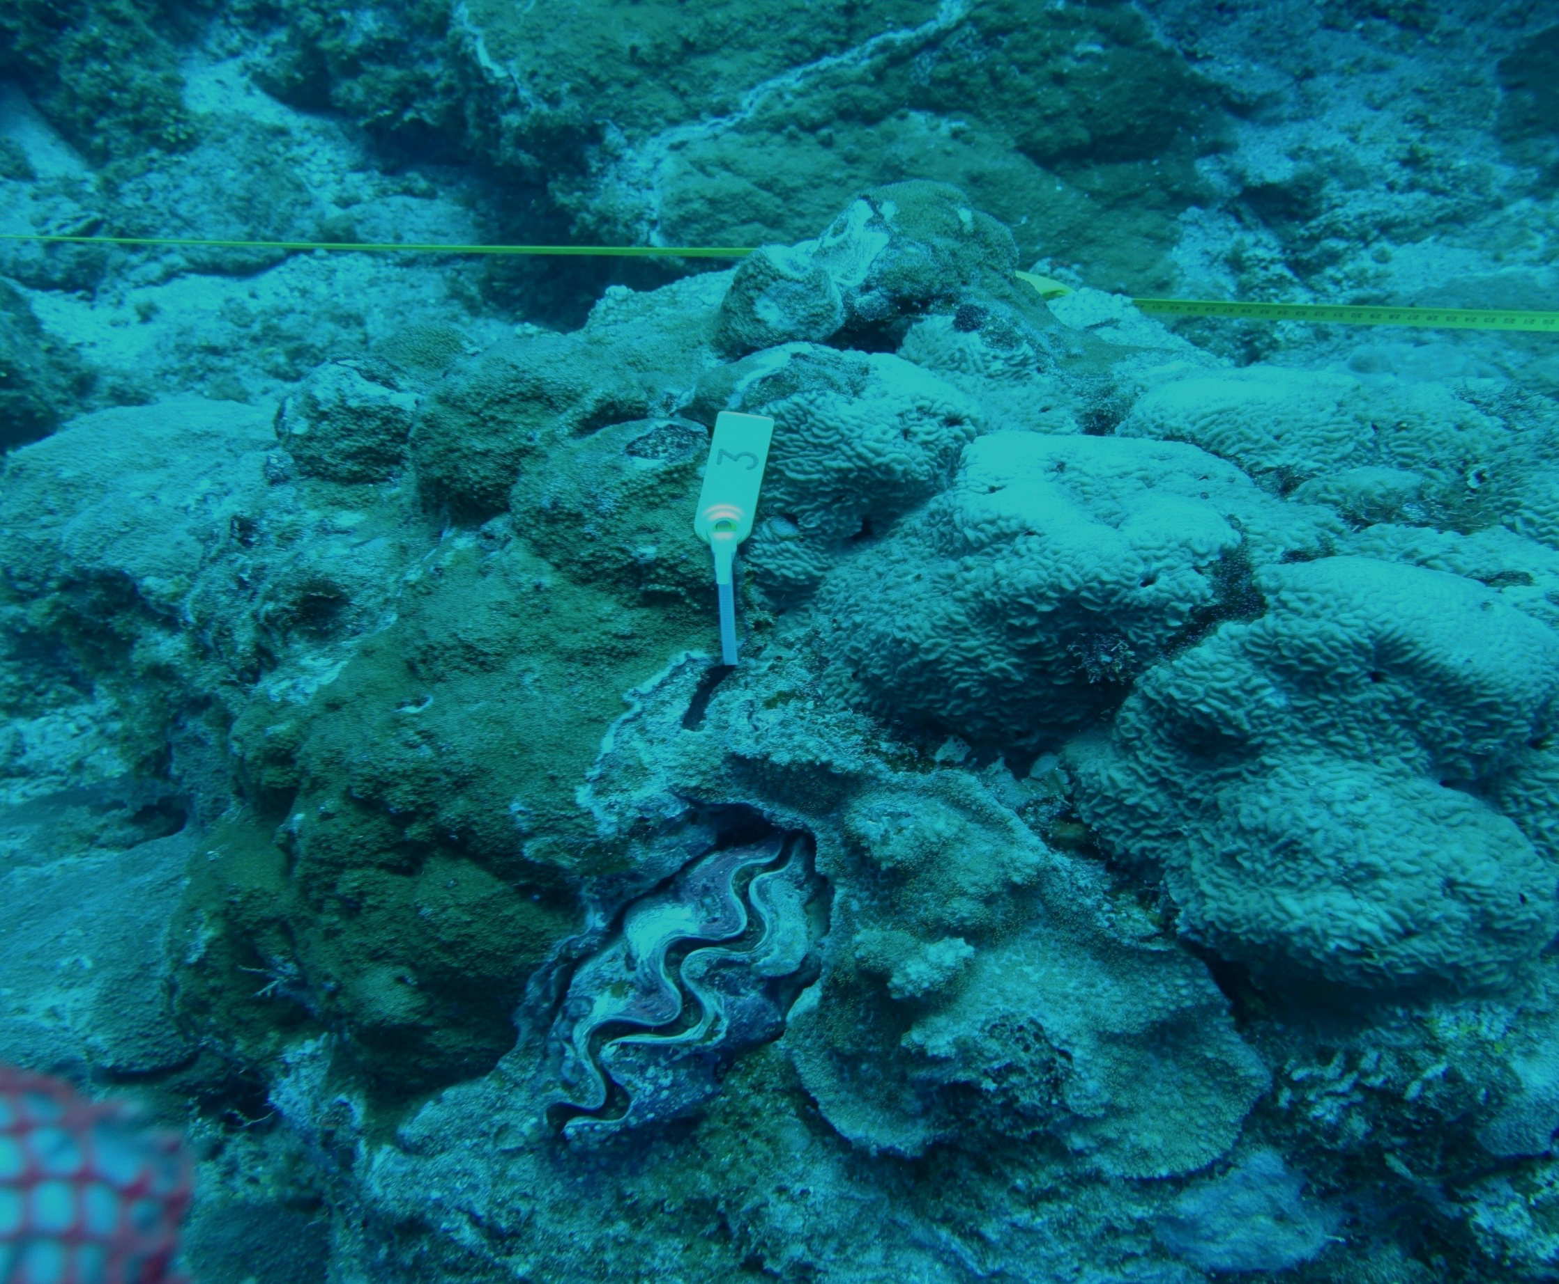
HYPOTHESIS
In comparing seawater depth with Faisua size and density, we hypothesize that there would be higher density and larger clam size in shallower depths because there would be better light availability for photosynthetic processes.
Notes:
In comparing these depths with faisua size & density

Slide 7
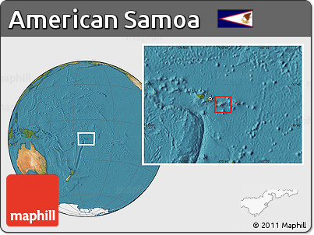
STUDY SITE
American Samoa is situated in the South Pacific Ocean, and is made up of 5 islands and 2 atolls.
Observations made in Fagasa Bay, Tutuila
Notes:
Source:
http://www.nationsonline.org/oneworld/american_samoa.htm
Tutuila
Aunuu
Tau
Ofu-Olosega
Rose Atoll
Swains island
PICTURE SOURCE:
http://maps.maphill.com/american-samoa/location-maps/satellite-map/free-rounded-satellite-location-map-of-american-samoa.jpg

Slide 8
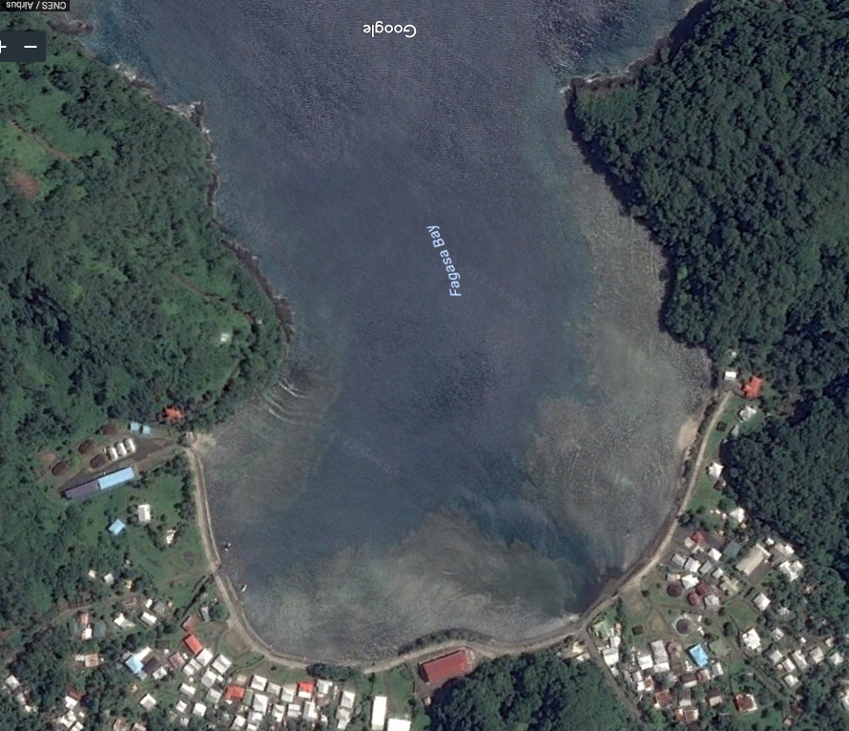
FAGASA BAY
Notes:
Fagasa Bay is located in Fagasa village in American Samoas largest island of Tutuila. The bay is isolated from majority of the population on the north side of the island.
Data was collected mainly on the bays reef slope and flat.
(Pictures provided from Google Earth)

Slide 9
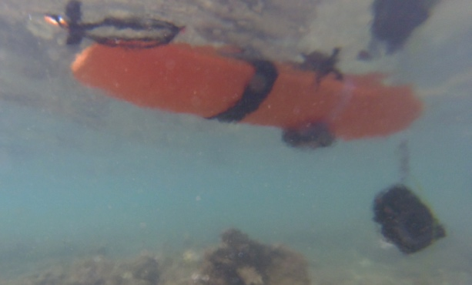
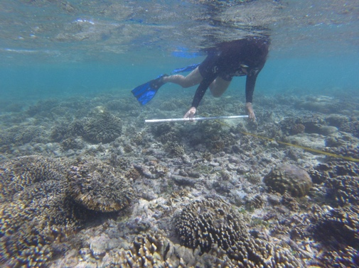
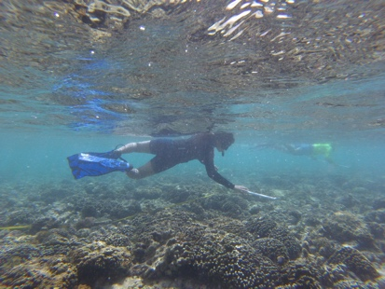
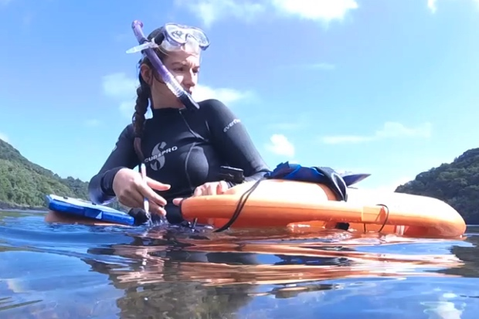
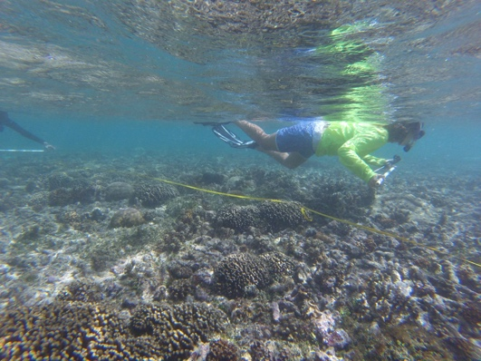
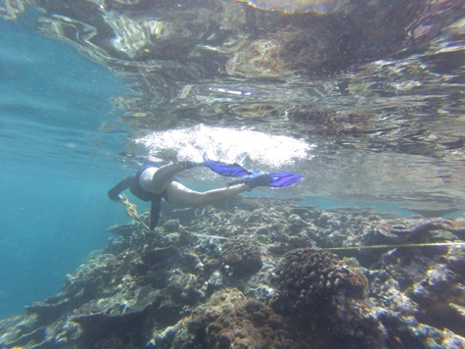
METHODS
Lay out 50m (length) x 2m (width) transect
Take starting and ending GPS point & time
Go along transect using 1m stick perpendicular to transect tape

Slide 10
METHODS
Faisua identification
Size
Color
Valve Margins
Photo-Intake siphon tentacles
Time/GPS

Slide 11
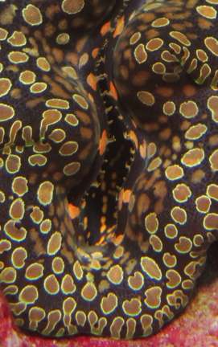
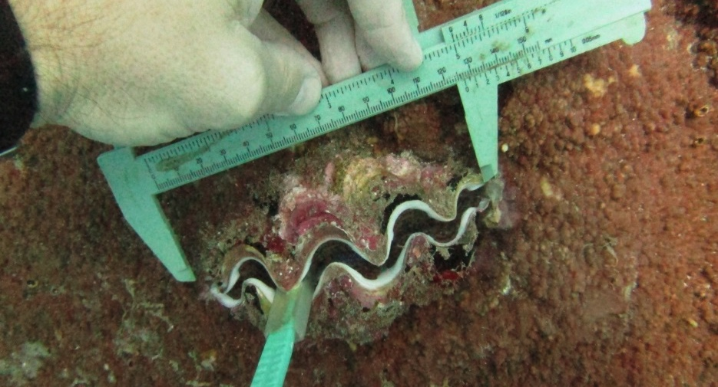
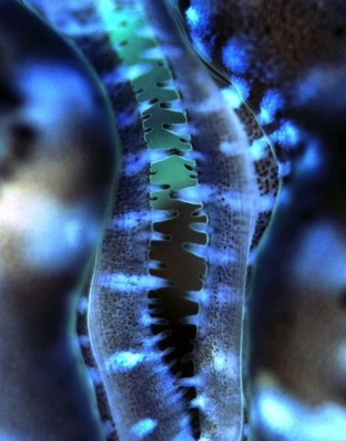
METHODS
When finding Faisua on transect
Take GPS point
Take photo(Surroundings, closer detail, intake siphon tentacle, shell)
Approach and sizing
Use calipers to measure length

Slide 12
METHODS
When finding Faisua on transect
Take GPS point
Take photo(Surroundings, closer detail, intake siphon tentacle, shell)
Approach and sizing(Use calipers to measure length)
Count valve margins

Slide 13
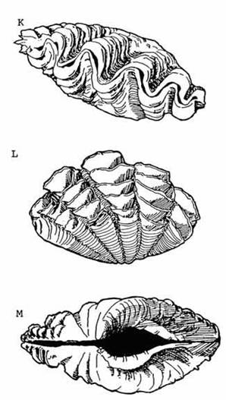
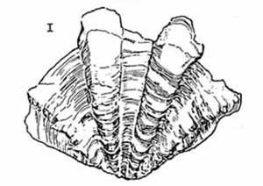
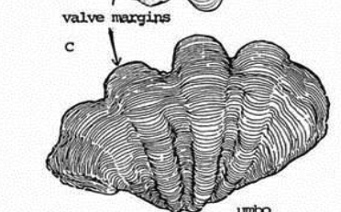
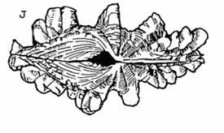
Valve Margins
Australian National Parks and Wildlife Service
Australian National Parks and Wildlife Service
Notes:
Fan shaped outline (bumps)
T.Squamosa – Bluntly pointed Valve margins that undulate with count of about 4-6,
T.Maxima – Valve margins undulate with about five generally sharply triangular

Slide 14
DATASHEET

Slide 15
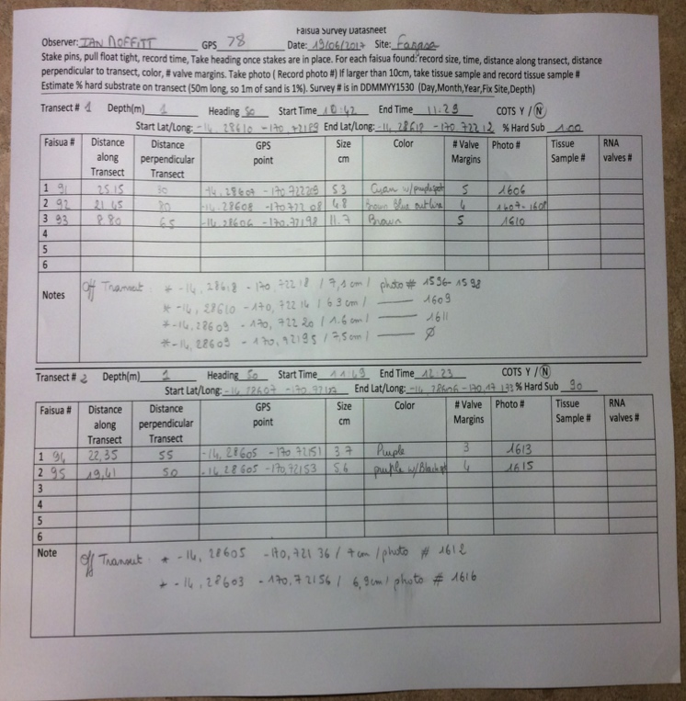
DATA
Conducted five 50m transects on Fagasa reef flat & slope
Transect 1&2 Faisua(s) on Transect: 5
Faisua(s) off Transect: 6
Total Count: 11

Slide 16
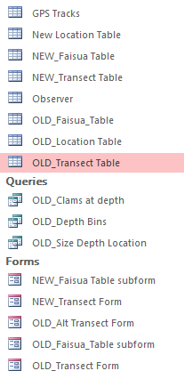
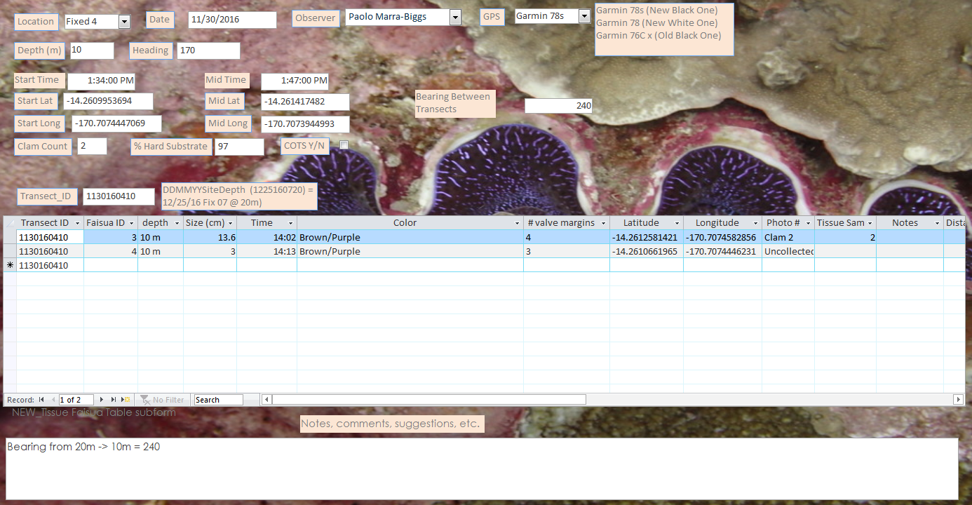
Data Entry
Data Input into Database
S:\Marine\MarineResources\ResearchProjects\Giantclams\Data
Notes:
Access database

Slide 17
RESULTS

Slide 18
Notes:
Different depth correlations with faisua density & size
-XAXIS: Shows the different depths we surveyed in
-YAXIS: Indicates faisua density which is the # of faisuas divided by total area surveyed (10-30m conducted in national park)
-one thing to mention , for results pertaining to 1m , its total area is only 500m2 as to 10-30m areas are 1800m2 (why)
18 transects per depth = 1800
-as to data shown there are 3 different color size bins that indicate light blue(1-7), dark blue(8-14), orange(15-40)

Slide 19
DISCUSSION
The reef-flat data and previous NPSA surveys at depths of 10m-30m suggest the shallower depths (1m-15m) had a higher density of Faisua. (Supports Hypothesis)
However, the majority of the Faisua density in shallow depths were of 1-7cm clams, and contained only a few number of larger clams(8-14cm, 15-40cm). (Faisuas may be poached)
Notes:
12cm being the greatest size at 1m depth(shallow), 33cm being the greatest size at 16m depth(shallow), 36cm being the greatest size at 20m depth(deep),and 30cm being the greatest size at 30m depth(deep)

Slide 20
MANAGEMENT IMPLICATIONS
Faisuas are most abundant in shallow depths, but mostly of sizes that are <12cm. An explanation for this, is that shallow depths can become easily accessible for fishermen
Solution
Start a Faisua hatchery to restock populations. Outplant at depths that are out of reach of typical poachers, but shallow enough for growth.
Enforce regulations on illegal poaching.

Slide 21
REFERENCES
National Park of American Samoa
Lucas, John S. “The Biology, Exploitation, and Mariculture of Giant Clams(Tridacnidae).”Reviews in Fisheries Science 2.3(1994): 181-223
Green, A., & Craig, P. (1999). Population size and structure of giant clams at Rose Atoll, an important refuge in the Samoan Archipelago. Coral Reefs, 18(3), 205-211
Notes:
References for my project

Slide 22
ACKNOWLEDGEMENTS
HEAVENLY FATHER
Family & Friends
NPSA Marine Crew
Ian Moffitt
Bert Fuiava
Victoria Barker
Paolo Marra-Biggs
Amelie Tagliaferro
Natosha Ripley
Johann Vollrath
Dr. Mark Schmaedick, American Samoa Land Grant
Pacific STEP-UP Program
American Samoa National Park Service

